Slide 1




Sakha theater (Russia) perform Macbeth in Moscow in 2009. Photo by Sergey Petrov.
Notes:
In 2016, the British Council is marking the 400th anniversary of Shakespeare’s death with events and activities which celebrate his life and work.

Slide 2


#ShakespeareLives – MOOC
William Shakespeare
What do you know about him?
His life? His work?
Fun international facts about Shakespeare
Notes:
What do the learners know about William Shakespeare?
Fun international facts about Shakespeare at: www.britishcouncil.org/voices-magazine/fun-international-facts-about-shakespeare
More information on Shakespeare Lives at: https://www.britishcouncil.pt/en/programmes/shakespeare-lives and http://www.shakespearelives.org

Slide 3


#ShakespeareLives – MOOC
Shakespeare Lives 2016 In 2016, the British Council is marking the 400th anniversary of Shakespeare’s death with events and activities which celebrate his life and work. Watch the short film on our website find out more.
Shakespeare Lives 2016 In 2016, the British Council is marking the 400th anniversary of Shakespeare’s death with events and activities which celebrate his life and work. Watch the short film on our website British Council | Shakespeare Lives to find out more.
Notes:
The short film on our website is 2 minutes 37 seconds, so ideal to show in class. Open the link (https://www.britishcouncil.pt/en/programmes/shakespeare-lives) to the film with the PowerPoint in presentation mode.

Slide 4



#ShakespeareLives – MOOC
Shakespeare Lives 2016 In 2016, the British Council is marking the 400th anniversary of Shakespeare’s death with events and activities which celebrate his life and work. Watch the short film on our website find out more.
Massive Open Online Course
Exploring English: Shakespeare
We invite and encourage you to enrol in this fantastic new online course to improve your English language skills by looking at the life and works of William Shakespeare and his enduring popularity
https://www.futurelearn.com/courses/explore-english-shakespeare
Notes:
British Council MOOCs (Massive Open Online Courses) are offered via the FutureLearn platform, the first UK-led provider of massive open online courses (MOOCs): https://www.britishcouncil.org/organisation/press/platform-provided-british-council%E2%80%99s-first-ever-moocs
From 11 January 2016, learners can improve their English by looking at the life and works of William Shakespeare with Exploring English: Shakespeare: https://www.futurelearn.com/courses/explore-english-shakespeare
The British Council’s first ever MOOC on the FutureLearn platform was Exploring English: Language and Culture: https://www.futurelearn.com/courses/explore-english-language-culture
The Understanding language: learning and teaching MOOC was developed in partnership with the University of Southampton and reflects our joint online MA in English Language Teaching: https://www.futurelearn.com/courses/understanding-language
The MOOC Understanding IELTS: Techniques for English Language Tests broke the world record for the biggest single run of an online course: https://www.futurelearn.com/courses/understanding-ielts

Slide 5
#ShakespeareLives – MOOC
Shakespeare Lives 2016 In 2016, the British Council is marking the 400th anniversary of Shakespeare’s death with events and activities which celebrate his life and work. Watch the short film on our website find out more.
Exploring English: Shakespeare
When? The MOOC starts on 11 January 2016.
How? Go to https://www.futurelearn.com/courses/explore-english-shakespeare and click on ‘Join now’.
Aim? To improve your English language skills by looking at the life and works of William Shakespeare and his enduring popularity.
Who is it for? The course is designed for people who are learning English, are at B1 level (on the CEFR) and are interested in the language and legacy of William Shakespeare.
Duration? 6 weeks - 2 hours study per week.
Cost? It’s free!
Notes:
Exploring English: Shakespeare MOOC
When? The MOOC starts on 11 January 2016.
How? Go to https://www.futurelearn.com/courses/explore-english-shakespeare and click on ‘Join now’.
Aim? To improve your English language skills by looking at the life and works of William Shakespeare and his enduring popularity.
Who is it for? The course is designed for people who are learning English, are at B1 level (on the CEFR) and are interested in the language and legacy of William Shakespeare.
Duration? 6 weeks - 2 hours study per week.
Cost? It’s free!

Slide 6
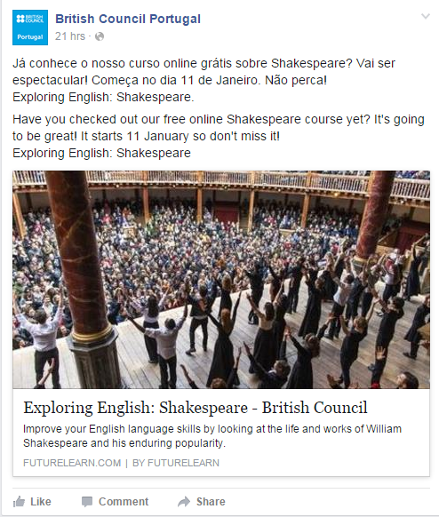
#ShakespeareLives – MOOC
Shakespeare Lives 2016 In 2016, the British Council is marking the 400th anniversary of Shakespeare’s death with events and activities which celebrate his life and work. Watch the short film on our website find out more.
Facebook - British Council Portugal
Notes:
The Exploring English: Shakespeare MOOC (https://www.futurelearn.com/courses/explore-english-shakespeare) is being advertising on the British Council Portugal Facebook page and British Council Portugal website: https://www.britishcouncil.pt/en/programmes/shakespeare-lives

Slide 7


www.shakespearelives.org
#ShakespeareLives
Schaubuhne am Lehniner Platz theater (Berlin) perform Hamlet in Moscow in 2010. Photo by Sergey Petrov.
Notes:
More information on Shakespeare Lives at: https://www.britishcouncil.pt/en/programmes/shakespeare-lives and http://www.shakespearelives.org
Hashtag: #ShakespeareLives

